Slide 1
MDL Tutorial Analysis
Jaylen Powell
Research Methods

Slide 2
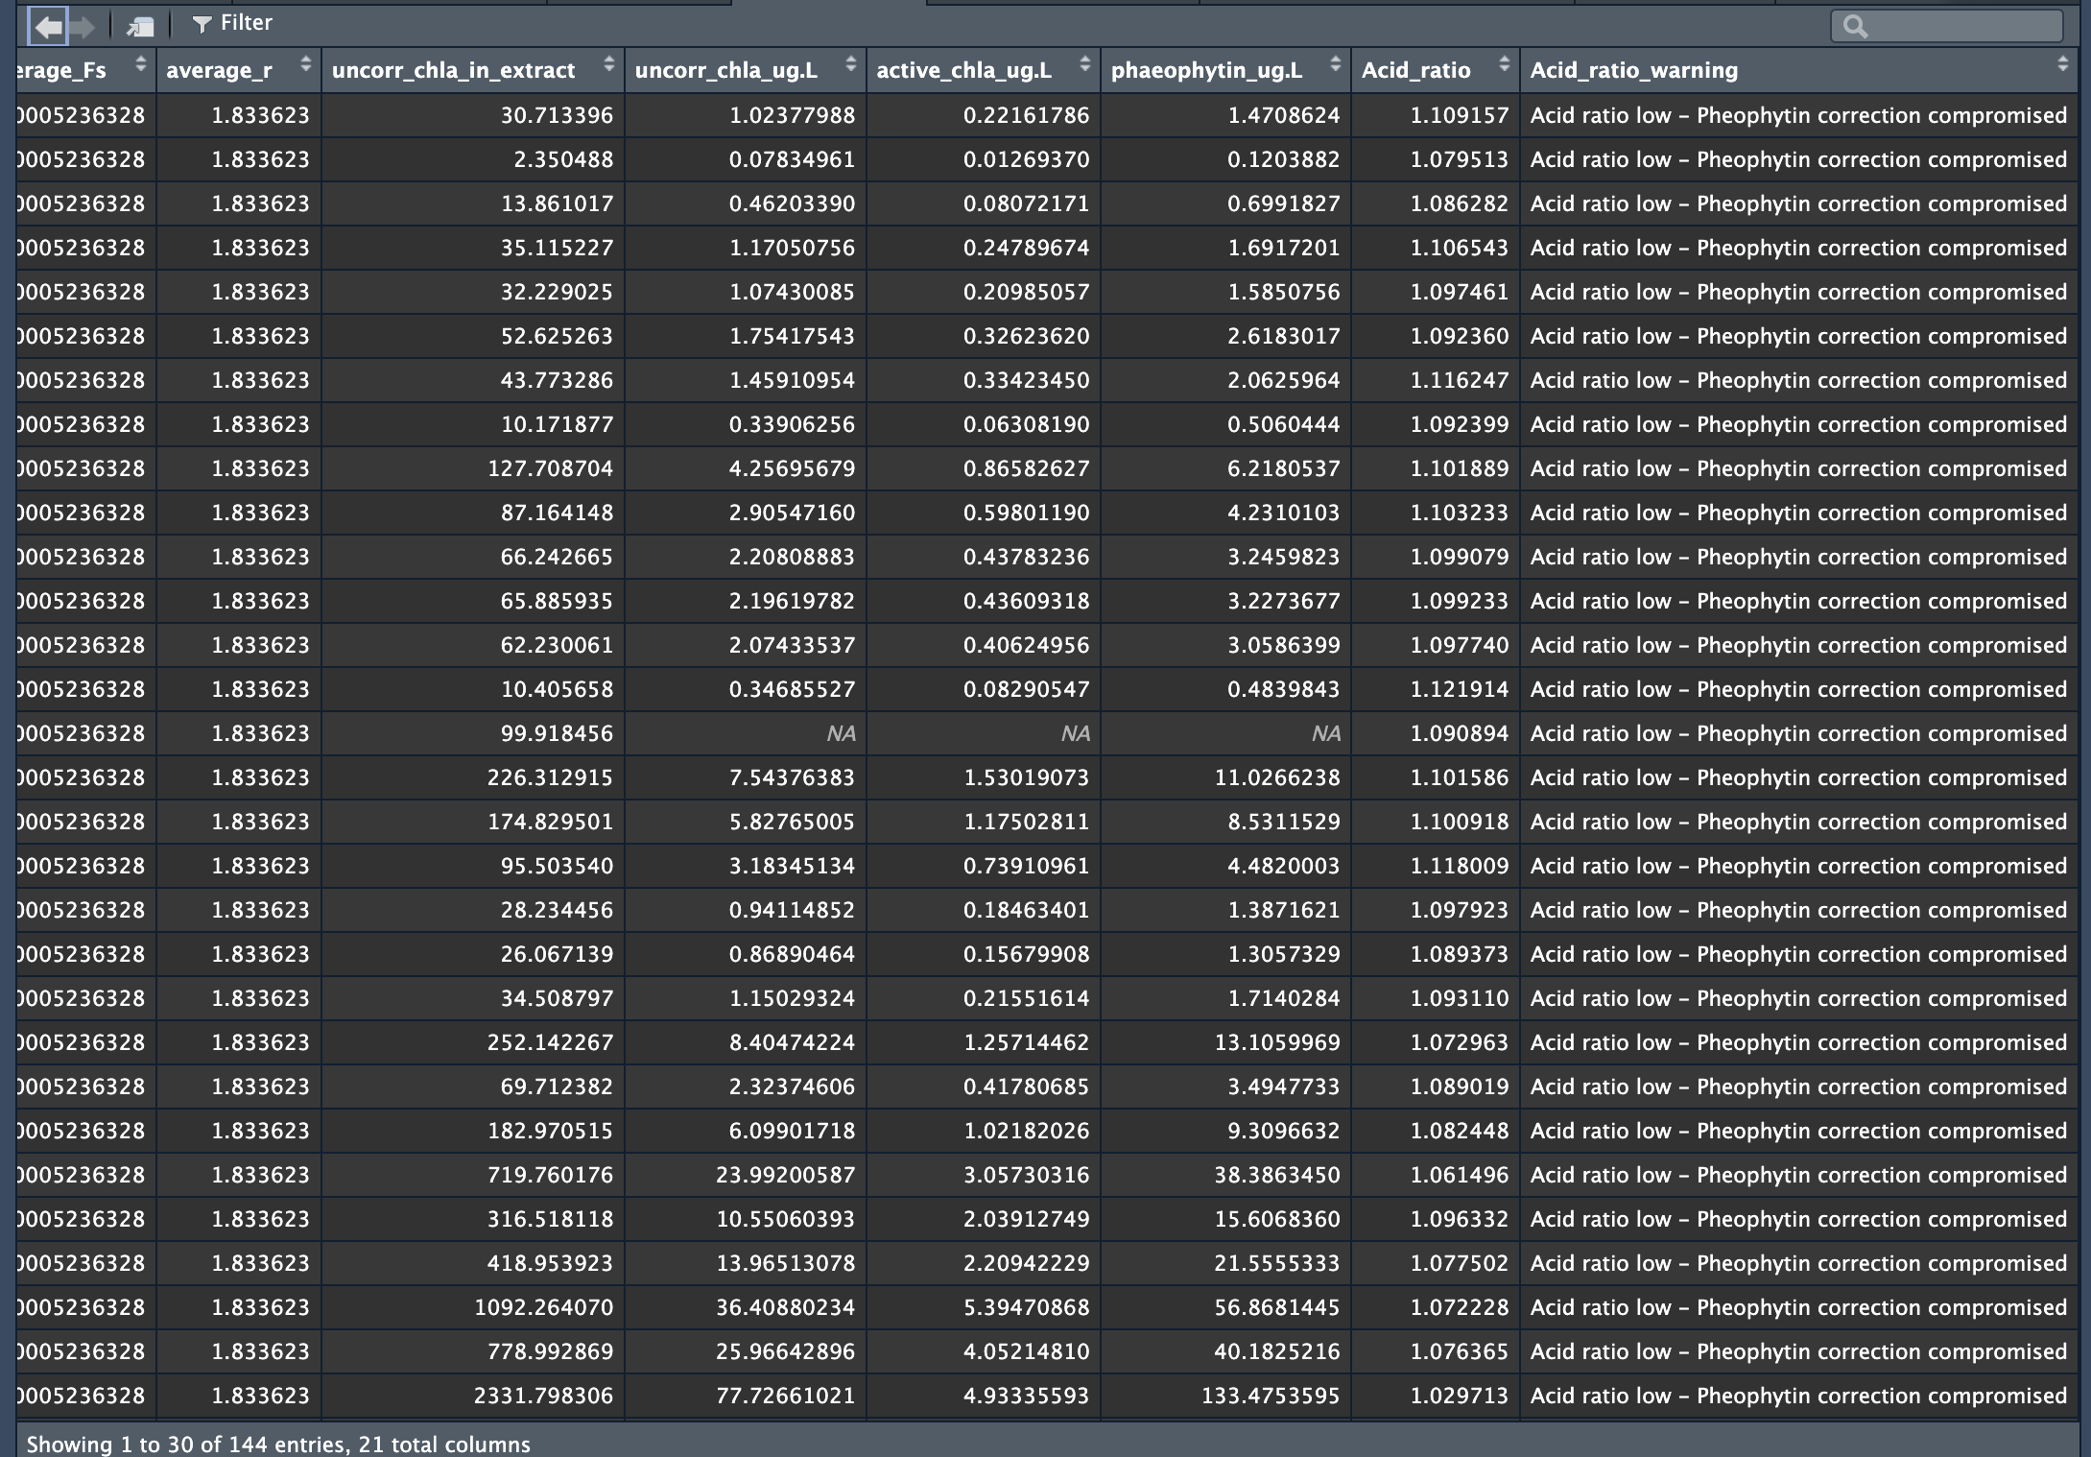
Fluorometry
Residual Effects
Noise
Inaccurate readings

Slide 3
Method Detection Level
The lowest concentration that can be reported at 99% confidence level.
MDL = “Standard deviation of lowest 7 samples” X “Critical t- value”

Slide 4
Other options…
Lower Detection Limit (LDL)
Represent lowest concentration of a substance
Limit of Quantification (LOQ)
Typically higher than the LDL based on signal-to-noise ratio, linearity,, and reproducibility
Practical Quantification Limit (PQL)
Accounts for instrument precision, sample matrix effects, and desired level of confidence
Instrument Detection Limit (IDL)
Doesn’t consider sample-specific factors, based on instrument’s sensitivity and detection capabilities

Slide 5
Why MDL?
Statistical Rigor
Using the lowest concentrations’ values and dF from Student’s t-test makes MDL have a more reliable threshold
Specific to instrument
MDL values are calculated based on the instrument’s performance with low concentration samples
Quantitative threshold
Able to distinguish between true signal and noise.

Slide 6
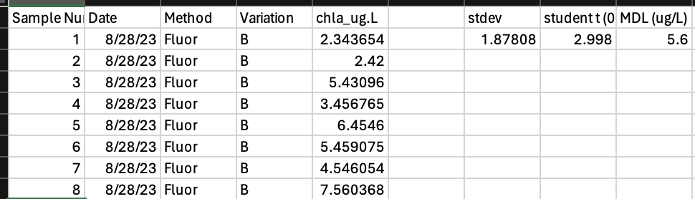
Comparing Data to …

Slide 7
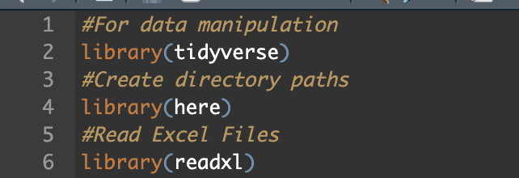
Install Packages

Slide 8
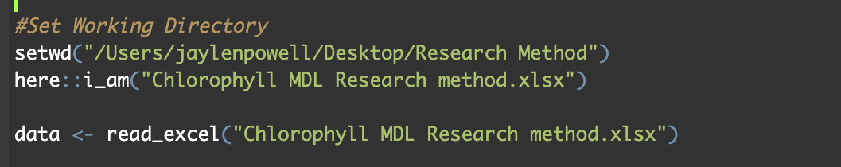
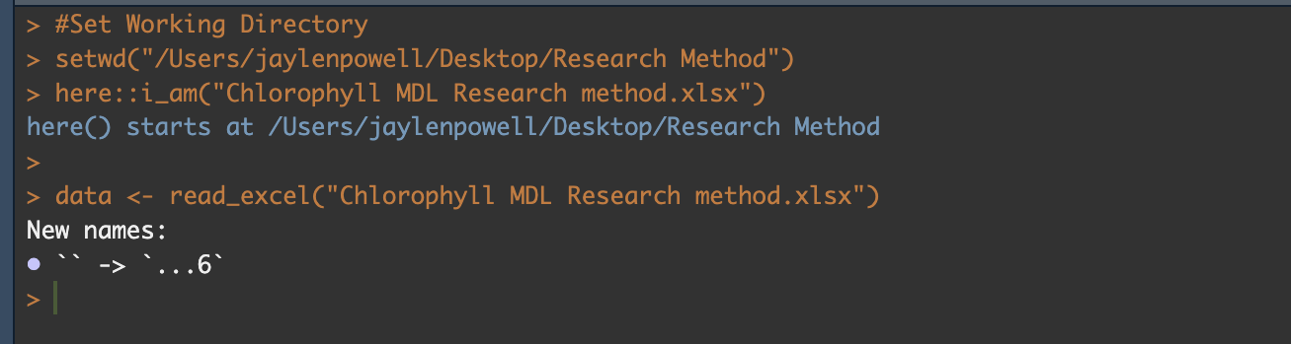
Finding The File…

Slide 9
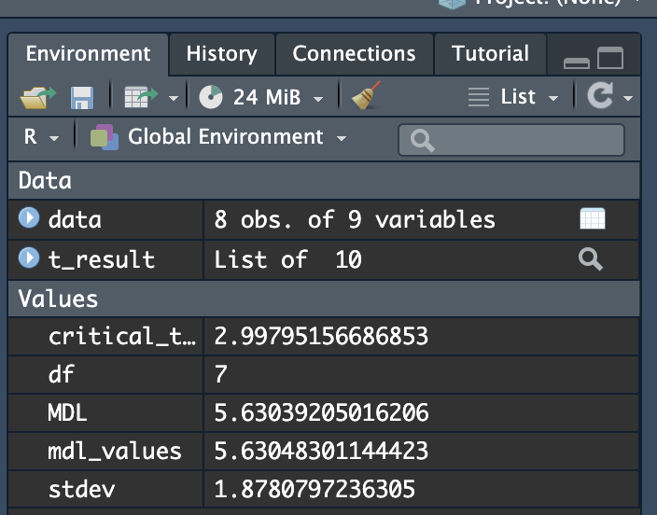
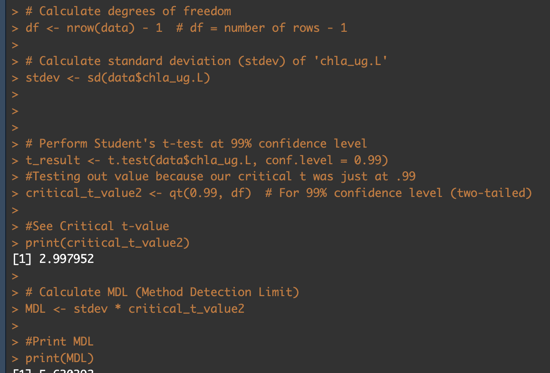
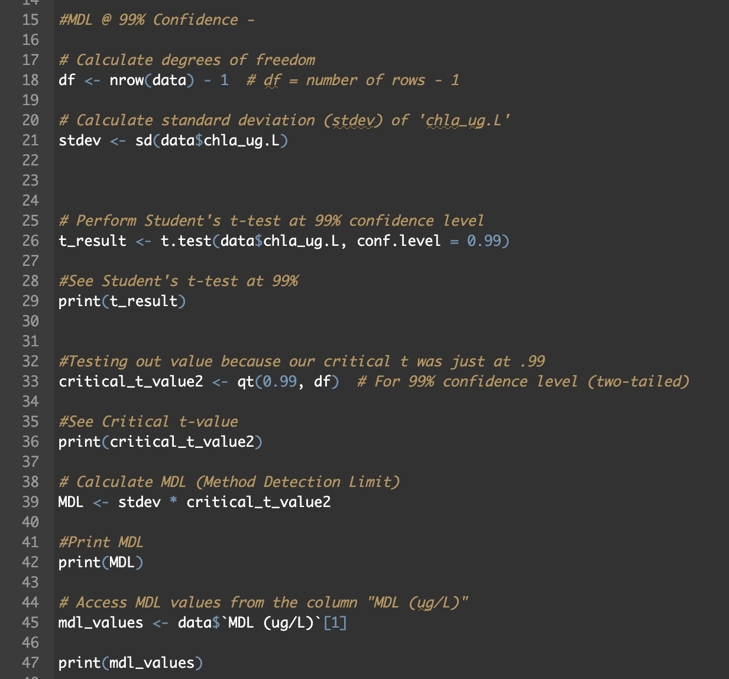
Finding MDL @ 99% Confidence

Slide 10
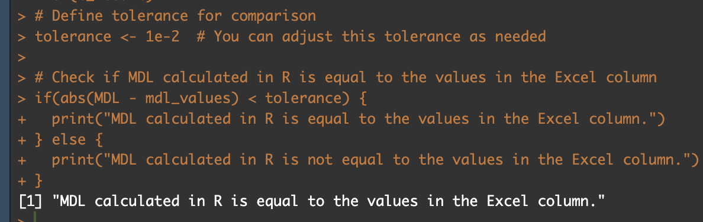
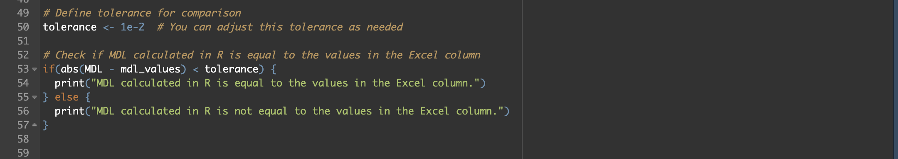
Compare R to Excel

Slide 11
From this
Use R to double check formulas in Excel
Able to find MDL strictly through code
Find threshold for analytical instruments’ noise – signal ratio

